Slide 1

MACHINE LEARNING -REGRESSION
Submitted by:
MAYANK CHOUDHARY
Roll. No. 35515002818
Serial no. 57 ECE-1

Slide 2
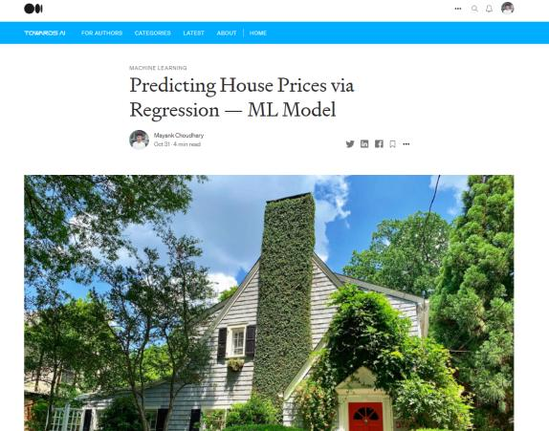
Github :
mayankchaudhary26

Slide 3
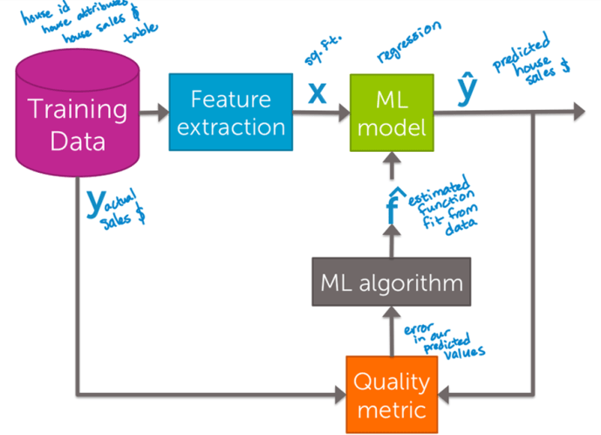
Training set = 80%
Test set = 20%
Flow chart

Slide 4
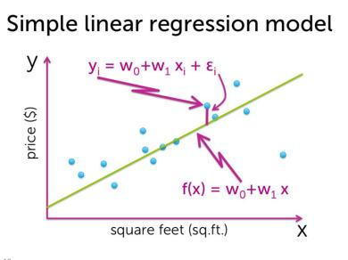
Simple Linear Regression
Given an input x we would like to compute an output y
In linear regression we assume that y and x are related
with the following equation:
y = wx+ε
y = w₀ + w₁x₁+ … + w_{k}x_{k} + ε
where w is a parameter and ε represents measurement
or other noise
What we are trying to predict
Observed values
RSS(w0,w1) = (yi-[w0+w1xi])^2

Slide 5
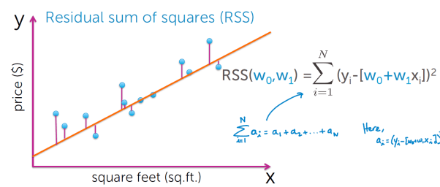
Residual Sum of Squares
RSS is the sum of the squares of the residuals and the residuals is just a fancy word for the difference between the predicted output and the true output.
2
RSS(w0,w1) = (yi-[w0+w1xi])

Slide 6
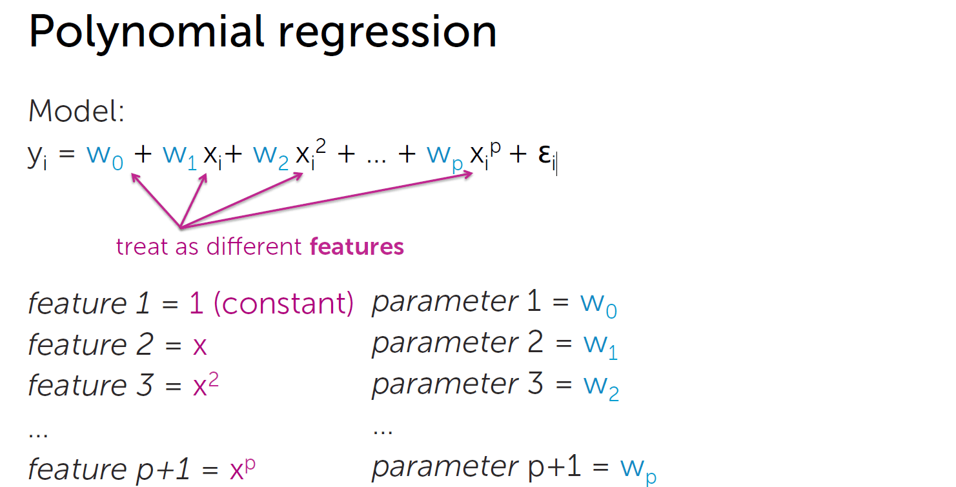
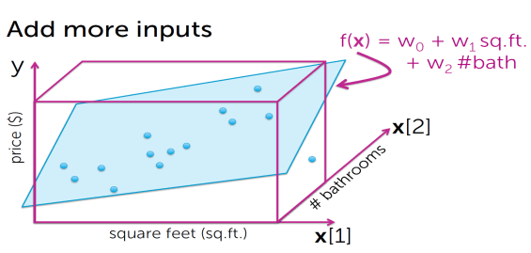
Multiple regression is an extension of linear regression models that allow predictions of systems with multiple independent variables. It does this by simply adding more terms to the linear regression equation, with each term representing the impact of a different physical parameter.
Residual sum of squares (RSS)
RSS(w0,w1) = ∑ (yi-[w0+w1xi])
y = w₀ + w₁x₁+ … + w_{k}x_{k} + ε

Slide 7
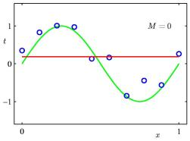
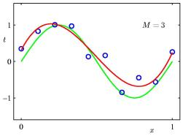
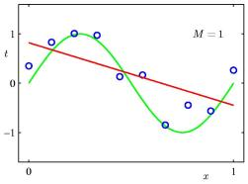
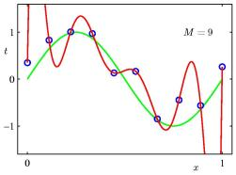
0th Order Polynomial
3th Order Polynomial
1th Order Polynomial
9th Order Polynomial

Slide 8
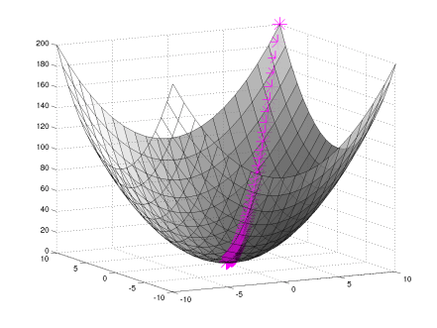
Gradient descent
In linear regression, the model targets to get the best-fit regression line to predict the value of y based on the given input value (x). While training the model, the model calculates the cost function which measures the Root Mean Squared error between the predicted value (pred) and true value (y). The model targets to minimize the cost function.
2
RSS(w0,w1) = (yi-[w0+w1xi])

Slide 9
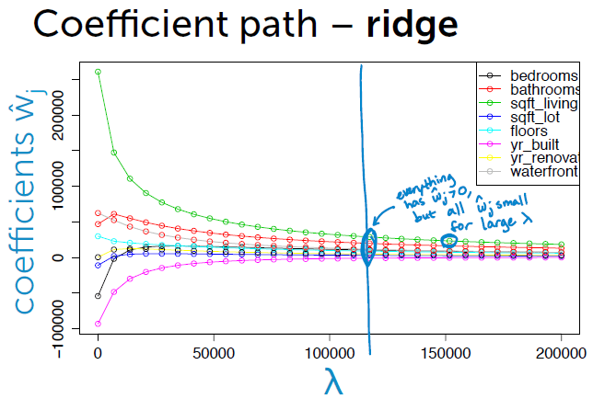
Ridge regression
(a.k.a L2 regularization)
ridge regression is a variant of linear regression, which penalizes sum of squared coefficients (L2 penalty)
2
RSS(w) + λ||w||
tuning parameter = balance of fit and magnitude
2

Slide 10
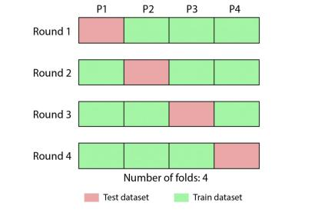
Selecting an L2 penalty via cross-validation
Cross-validation is a resampling procedure used to evaluate machine learning models on a limited data sample. The procedure has a single parameter called k that refers to the number of groups that a given data sample is to be split into. As such, the procedure is often called k-fold cross-validation.

Slide 11
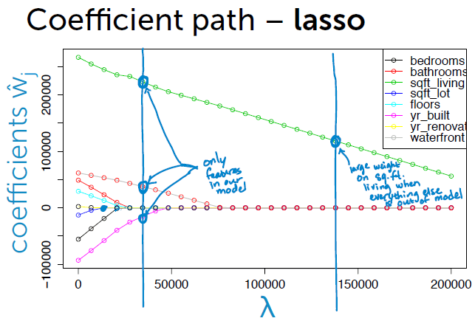
Lasso regression:
L1 regularized regression
Lasso method overcomes the disadvantage of Ridge regression by not only punishing high values of the coefficients β but actually setting them to zero if they are not relevant. Therefore, you might end up with fewer features included in the model than you started with, which is a huge advantage.
RSS(w) + λ||w||
1

Slide 12
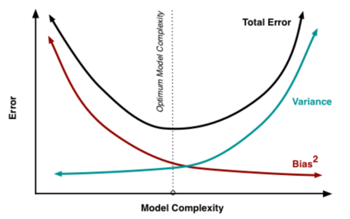
Bias-variance tradeoff
2
MSE = Bias + Variance
Large λ:
high bias, low variance
(e.g., ŵ =0 for λ=∞)
Small λ:
low bias, high variance
(e.g., standard least squares (RSS) fit of
high-order polynomial for λ=0)
Bias is the difference between the true value and our fitted line
Variance is the error from sensitivity to small fluctuations in training set

Slide 13
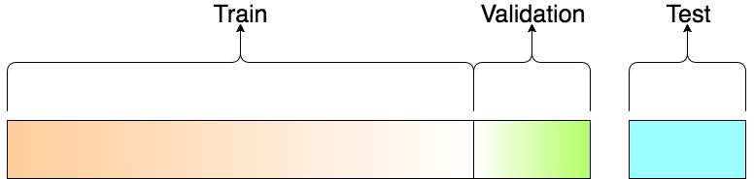
How to choose λ
If sufficient amount of data…
assess
generalization
error of ŵλ*
test performance
of ŵλ to select λ*
fit ŵλ

Slide 14
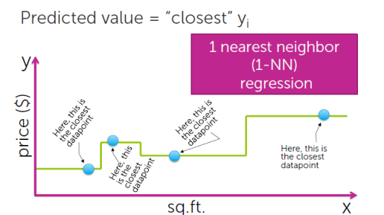
Nearest neighbor regression
The NN algorithm is a robust and versatile classifier that is often used as a benchmark for more complex classifiers such as Artificial Neural Networks (ANN) and Support Vector Machines (SVM)
In 1D, just Euclidean distance:
distance(xj,xq) = |xj-xq|

Slide 15
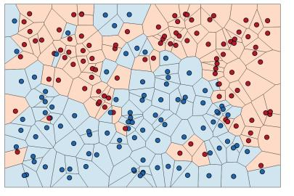
K-nearest neighbor
K-nearest neighbor algorithm essentially boils down to forming a majority vote between the K most similar instances to a given “unseen” observation. Similarity is defined according to a distance metric between two data points. A popular choice is the Euclidean distance given by
d(x,x′)= −−−−−−−−−−−−−−−−−−−−−−−
√ (x1−x′1)2+…+(xn−x′n)2

Slide 16



Biblography
Coursera: ML Specialization – Regression course
Wikipedia
Google images

Slide 17
THANK YOU

